Slide 1

https://www.uni-goettingen.de/en/48115.html
UNPLAB-QuGen_Ch-13[GenetCov I]
Quantitative Genetic modelling of Genetic Similarity between Relatives
(Genetic Covariance)
1

Slide 2
Sequential Number: #47
UNPLAB-QuGen_Ch-13[GenetCov I]
Unless I explicitly state otherwise, images and cartoons are created using ChatGPT.
You may use this material free of charge under the terms of the CC BY license. This requires that you provide appropriate attribution to the author:
W. Link, University of Goettingen, Germany.
In a few cases, individual images, photographs, or similar material may be subject to a more restrictive Creative Commons license. Where this applies, it is explicitly indicated, and you must comply with the stated license terms for those items.
Please check the license information carefully before reuse. Responsibility for complying with the applicable license terms rests entirely with you.
2

Slide 3
You already know:
Population Genetics (HWE, Inbreeding, Drift, Selection, Equilibrium of Selection and Mutation, Equilibrium of Selection and Drift, Gamete Phase Disequilibrium; the decomposition of the Phenotypic Variance, GxE inlcuding Stability and Breeder‘s Equation; Breeding Methods incl. Heterosis, GCA, Recurrent Selection Schemes, and the Four Categories of Plant Breeding with their Methods; Correlated Traits and Index Selection; The parameters of the Metric Model and of the Statistical Model, the decomposition of the Genetic Variance. Quantitative modelling the Generations F1, F2 and so forth in a Mendelian cross.
Keywords of this chapter: Kinship f (Coefficient of Coancestry) between relatives such as parent-offspring and siblings; Inbreeding due to crossing relatives.
Algebra as introduced in this chapter: Nearly none.
3

Slide 4
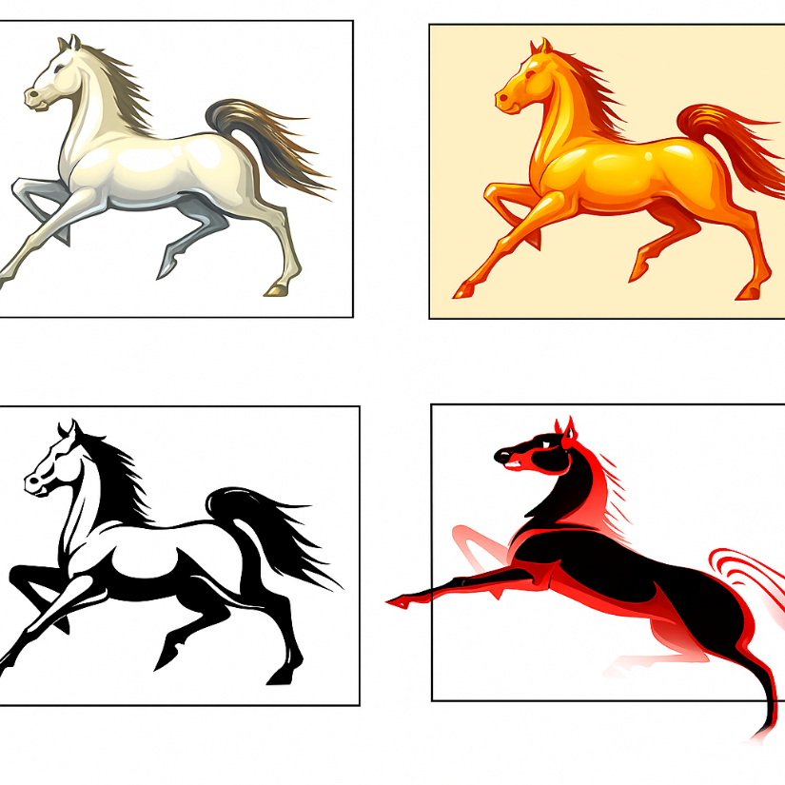

Genetically caused, inherited similarity between candidates is crucial for realizing gain from selection (and for evolution, anyway).
Similarity is relative.
Without the tiger, the reddish horse would have been the off-type; the dissimilar one. Yet. As we enlarge the diversity and add the tiger, the red horse just belongs to the group of horses and appears ‘at a sudden‘ much less dissimilar to its fellow horses than in the moment before.
4

Slide 5
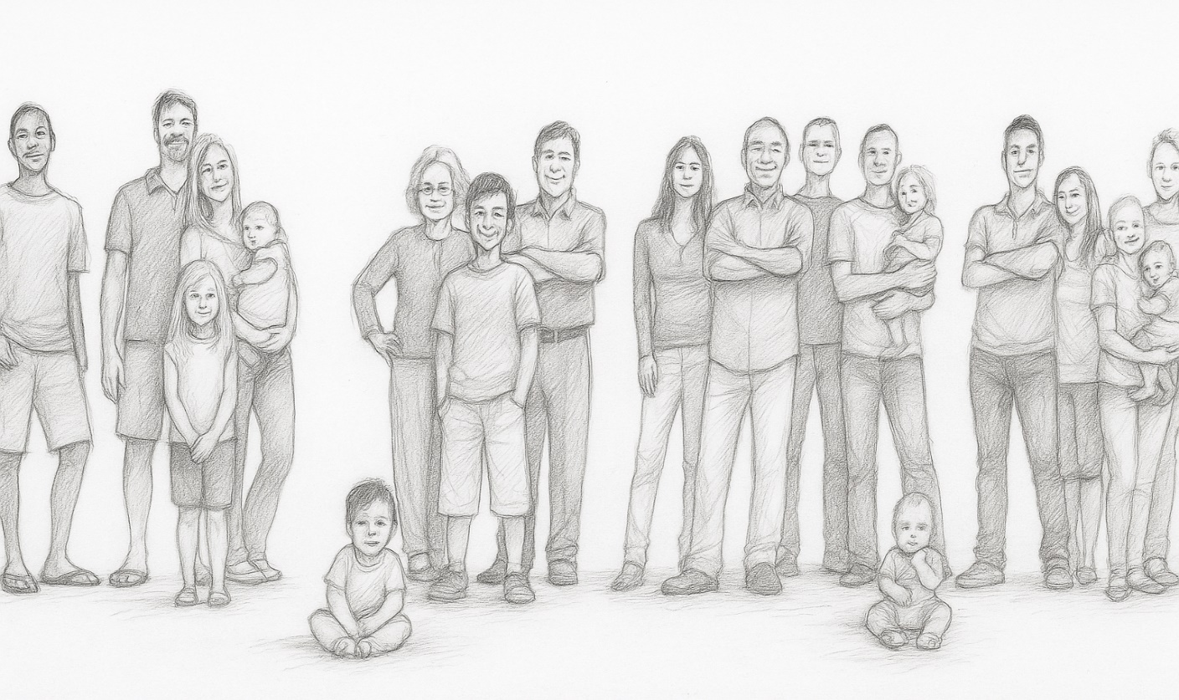
We study families: Genetic Similarities between parents & offspring and among offspring.
Similarity is grasped as Covariance (‘cov’, or at times ‘ω‘);
Diversity is grasped as Variance (‘var’, or ‘σ²’, as you very well know meanwhile).
We (will) find that in Hardy-Weinberg-Equilibrium, the ‘amount of genetic similarity’ within the families equals the ‘amount of genetic dissimilarity’ between families (within families means between the members of a family; referring to an ‘average’ aka ‘typical’ family).e genetic variance within the families plus the genetic variance among the families sums up to the total amount of genetic variance (available in the given population).
We (will) see that inbreeding of parents increases similarity between their offspring (within families) and therefore increases the variance between families.
Four families. Human families.
5

Slide 6
We study families, and the genetic similarities between parents & offspring and among offspring.
Similarity is grasped as Covariance (‘cov’, or at times ‘ω‘);
Diversity is grasped as Variance (‘var’, or ‘σ²’, as you know).
We (will) find that in Hardy-Weinberg-Equilibrium, the ‘amount of genetic similarity’ within the families equals the ‘amount of genetic dissimilarity’ between families (within families means between the members of a family; of an average aka typical family).
We (will) find that the genetic variance within the families plus the genetic variance between the families sums up to the total amount of genetic variance (available in the given population).
We (will) see that inbred parents lead to higher similarity between their offspring (within their family) and therefore higher variance between such families than non-inbred parents (let us hope that human parents are always non-inbred – you know why ... ‘genetic load’*).
*Inbreeding and consequences in pharaohs.
Hawass Z, et al., 2010: Ancestry and pathology in King Tutank-hamun's family. JAMA 17; 303(7): 638-47.
DOI: 10.1001/jama.2010.121.
6

Slide 7
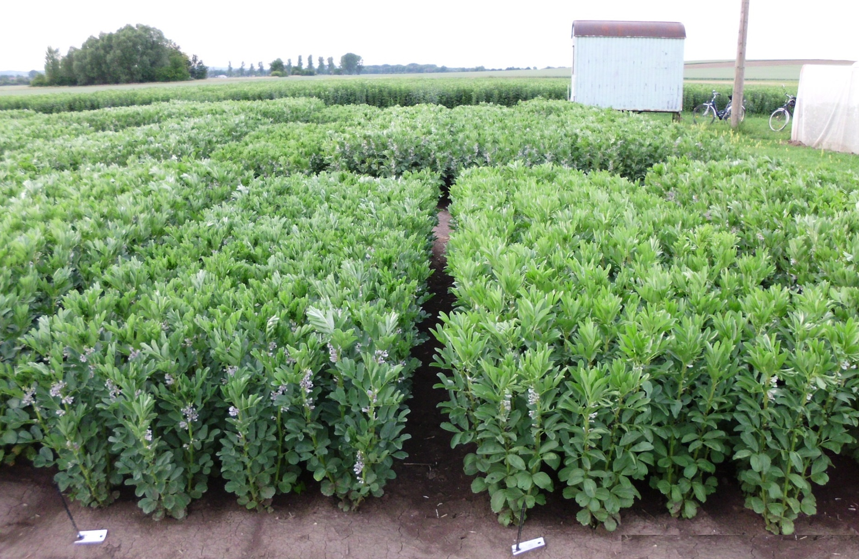
We study families; genetic similarities between parents & offspring and among offspring.
Watch out. Since we mostly deal with annual creatures (rather faba beans, sunflower or potato than cattle, chicken or beech trees), therefore parents do not belong to such families. Mostly, family means ‘kids-only’.
Of course we may nevertheless have parents included when testing for performance. It is for sure mostly a good idea to include them and gladly also include the F1 gene-ration and even the F2-total-bulk (if you can).
Yet. This is then, if you take it very carefully, not exactly the F1 indivi-dual(s) or the F2 bulk or so ... from which the family actually descends, but a genetically identical variant produced as new seed of the same. Remember: ... ‘►annual’ ;-)
Faba bean plots at Reinshof, Göttingen
© R.M.
7

Slide 8
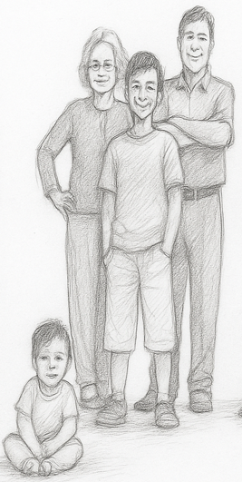
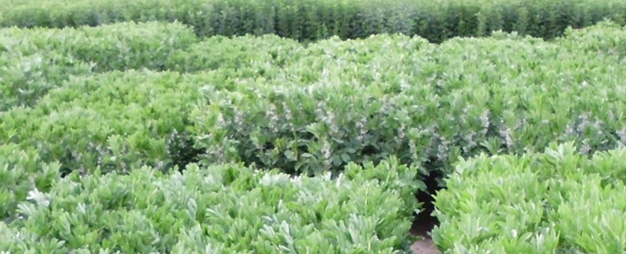
The genetic relationship (similarity) between relatives (covariance, correlation, regression) can be quantified in terms of σ²_{A} and σ²_{D} .
This is the topic of the pages to come.
Terms:
(Coefficient of) Relatedness. Relatedness is a rather common sense terminology, such as ‘an individual has, to herself, a relatedness of 1’; meaning ‘identity’.
Kinship, Consanguinity, Coancestry:
Quantitative-Genetic parameter. ‚An individual to itself‘:
This kinship is not necessarily with value 1.0
8

Slide 9
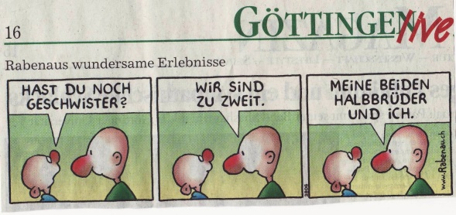
Genetically related individuals are similar in phenotype. The tighter the genetic relation-ship is, the stronger is (usually, as expectation, on average) their phenotypic similarity.
Göttinger Tageblatt
Similarity between relatives is based on them having more identical genes than if unrelated. Such identical genes were inherited from common ancestors. The extent of phenotypic similarity will, for sure, be influenced by environmental effects: Full-sib siblings (like brothers and sisters in humans) if raised under similar conditions will be more similar than if raised under different environmental conditions.
Most important for us are genetic similarities between
- Offspring and parent,
- Half-sibs (half-sib siblings; Halbgeschwister)
- Full-sibs (full-sib siblings; Vollgeschwister).
Rabenau's wondrous experiences. “Do you have any siblings?” .. “There are two of us” .. “My two half-brothers and me” www.rabenau.ch/rabenau_de.php
Already from visual inspection, we know that the similarity between relatives, e.g., between full sibs, depends on the actual case. This rests mainly on sampling effects when genes (i.e., alleles) are transmitted from segregating parents to offspring; and on random differences in the degree of parental heterozygosity (for the loci controlling variation of that trait)*.
*It seems to me as if this was a strong sentence ☺
9

Slide 10
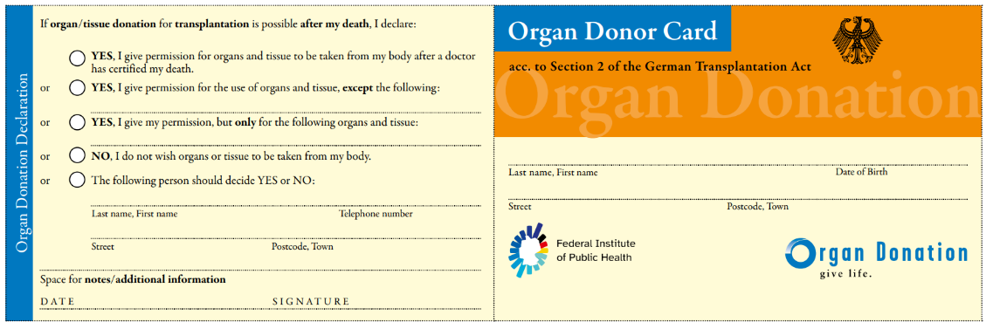
Full-sib siblings ( Fullsibs, FS); Half-sib-siblings (Half-sibs, HS); Parent-offspring; etc.
Göttinger Tageblatt
Focusing on application, it is the average (the typically to be expected) similarity between individuals of a given related-ness (such as full-sibs or half-sibs) in a given breeding population which is of interest to us.
Rarely we are interested in single cases, since these typically can not be well predicted hence nor be well exploited. Yet, the - expected ☺ - deviations of single cases from the big picture is of interest, of course. Why? Well, they can be expected, hence planned, managed, exploited.
www.rabenau.ch/rabenau_de.php
To make a starting point: What do you believe, which relatives are tighter related (narrower kinship, larger kinship-coefficient) to each other: Two full-sib siblings ... or a parent and her (his) child?
Generally, kinship between two genotypes is meant genome-wide – traditionally based on pedigree.
But we could as well focus only on those loci that contribute to the genetic
(co)variation of a specific trait. In GS, the concept of ‘trait-specific genomic
similarity already exists’ (cf. UNPLAB-BrMeth_Ch-11[TheFour GS]).
Kidney shape
To imagine an application to this question: Who may be the better donor of a kidney for a person – one of the person's parents or one of the persons’ full-sib sibling?
Of course we ignore here age and health status of donor and psychological and ethical issues etc.; d’accord?
www.organspende-info.de
10

Slide 11
Variability within groups vs contrast between groups.
Even if there is some heterogeneity within each of the three groups, clearly and easy-to-see there are clear contrasts. The groups can be identified as -type, as -type and as -type.
Here, it is slightly less simple, less clear. As soon as the heterogeneity within the groups increases, the contrasts decrease, type-identifica-tion and ease-of-classification decrease accordingly.
As soon as the diversity within groups is similarly large as the general diversity, differences between groups vanish. Nota bene: The overall or you may say the joint diversity need not be smaller nor larger, diversity is just less organized, more at random.
11

Slide 12
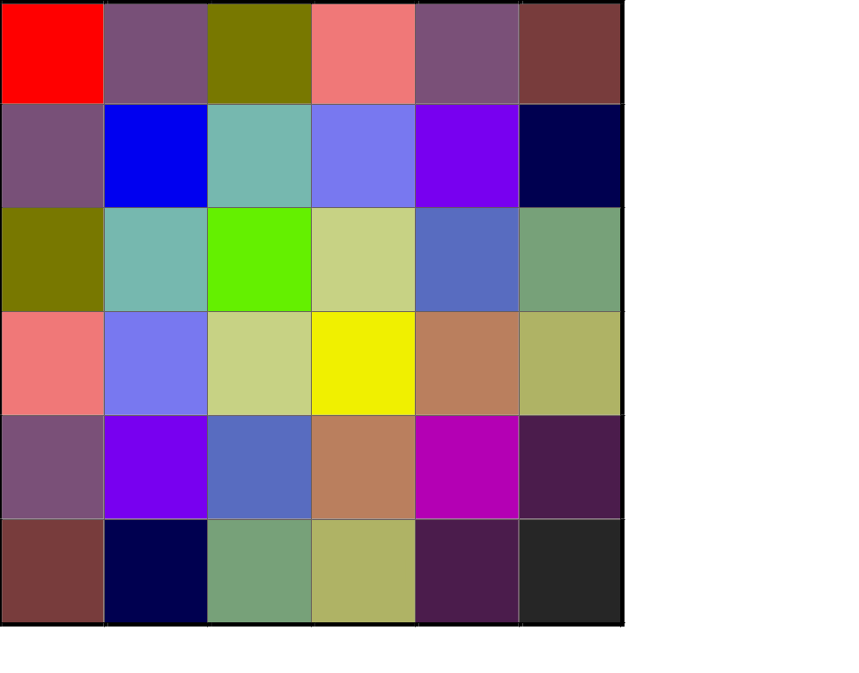
The conceptual ‘Population’ consists of unrelated individuals ... and of related ones ?!
Even if our ‘famous’ conceptual reference HWE population is ideal (N=∞, random mating, LD=0 etc.): There will always be relatives.
There is no reason to assume that the number of offspring from two parents would always be N=1 (i.e. no siblings occur); or that one genotype only mates with one other genotype (i.e. no half-siblings). In our reference population, there are necessarily groups of relatives: Families of full-siblings, of half-siblings, there are also e.g. cousins. Full-sib families and half-sibs are Cardinal Cases in Recurrent Selection and Cultivar Development, just think of ‘Recurrent selection for GCA’ or Topcross Test and Diallel Test in Hybrid Breeding (UNPLAB-BrMeth_Ch five, six, seven).
The total genetic variance in our conceptual HWE population can be divided into ‘between-family variance’ and ‘within-family variance’. Together this gives the total quantum of genetic variance of the Population (between its individual members).
36 genotypes, shown as 36 coloured squares.
Colour mimics ‘trait’. Take 36 as ‘many’, as approx. N=∞ ;-)
Be aware that so far, nobody is inbred; although there are indeed relatives in the population, N=∞. Hence, although relatives exist, the probability that relatives mate with each other (and thus produce inbred offspring) is
approximately zero. It is a model. Admittedly.
12

Slide 13
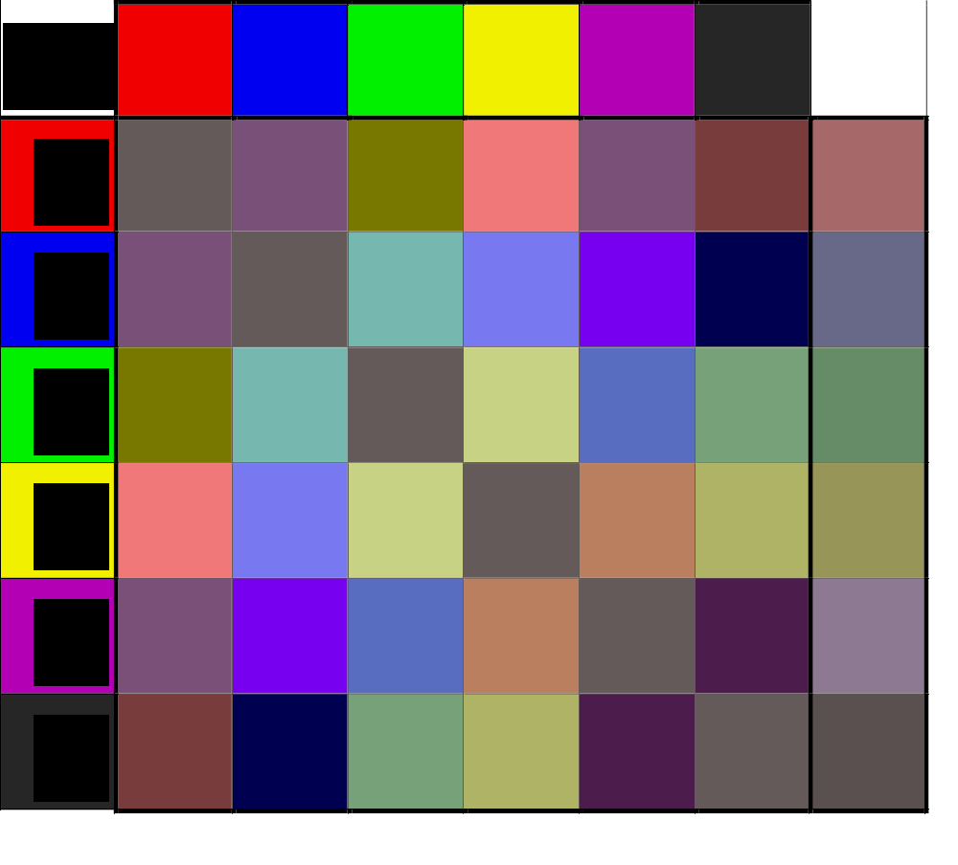
Colours indicate clear contrasts between HWE individual; less clear between their FS families; even-less clear between half-sib offspring. Caution: Different from the Diallel-GCA setting, here parents are non-inbred. The colour analogy isn’t perfect, don’t ask about locus, allele, gene action, mono-polymorphic et cetera.
Top-row and left-most column (grey frame) with clear colours (red, blue, green, yellow, violet, black): The N=∞ genotypes of the ‘HWE population’. No, it is not N=6, it wants to be N=∞: You get the point. The diagonal is fake-colour. Why? For instance, crossing one red with another red should make a reddish FS-family. Yet. The probability to mate two such reds with each other is zero. Here, the diagonal is 6/36=1/6, but with N=∞, the diagonal would be 1/∞ = 0. Therefore I filled the diagonal with an inconspi-cuous camouflage colour, so as not to disturb the intended visual effect ;-) which is: All these FS families show an unclear mixture of colours (as average of their members) based on the clear colours of their respective parents.
The right-most column shows the mean of all offspring from crossing one genotype (such as red) with all-other genotypes, i.e., it shows the colours of the N=∞ ;-) half-sib families in this imagined-visualized HWE-population.
Mix of these FS make the red parent‘s HS
13

Slide 14
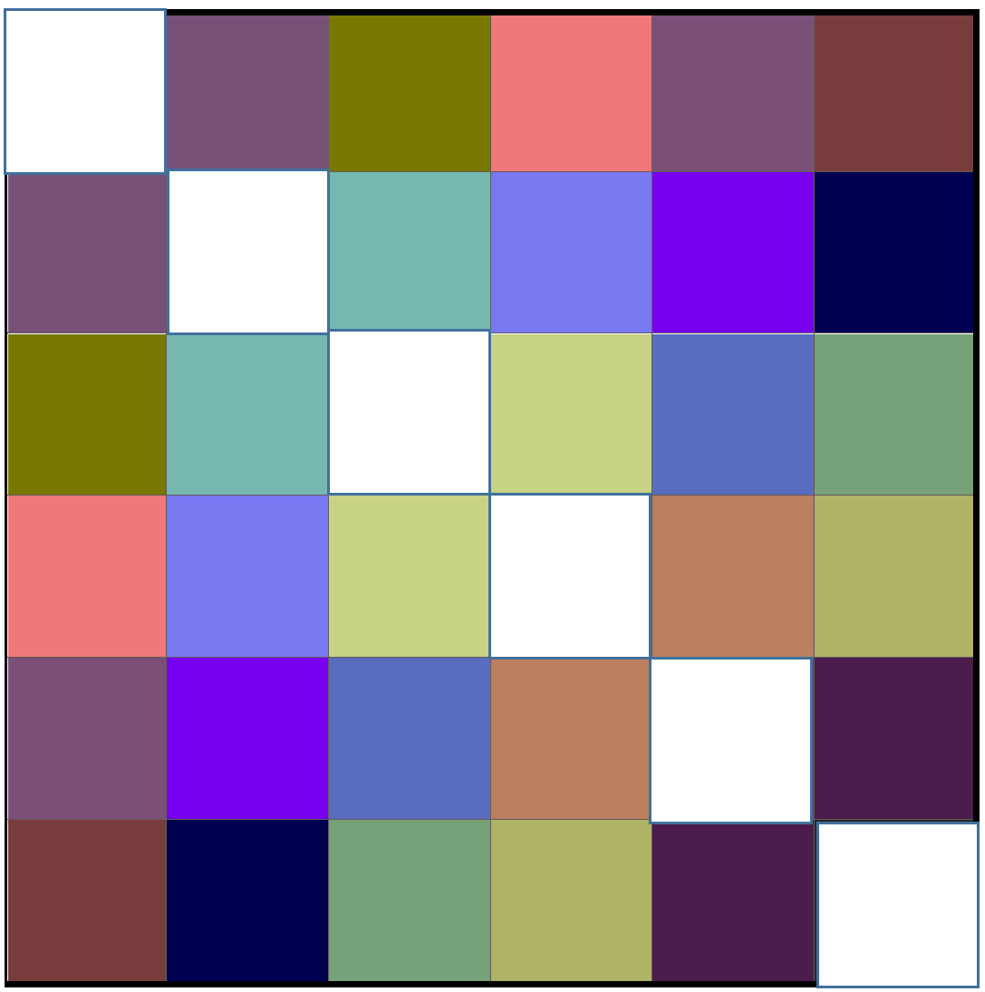
Colours indicate clear contrasts between HWE individual; less clear between their FS families; even-less clear between half-sib offspring. Caution: Different from the Diallel-GCA setting, here parents are non-inbred. The colour analogy isn’t perfect, don’t ask about locus, allele, gene action, mono-polymorphic et cetera.
Three HS-family as example cases; colour is mean value (colour) of their members. Although the differences can still be told, slightly more or less reddish-blueish-greenish, the differences are very much blurred, obfuscated.
Diagonal white
14

Slide 15
Colours indicate clear contrasts between HWE individual; less clear between their FS families; even-less clear between half-sib offspring. Caution: Different from the Diallel-GCA setting, here parents are non-inbred. The colour analogy isn’t perfect, don’t ask about locus, allele, gene action, mono-polymorphic et cetera.
Three HS-families as example cases; colour indicate mean value of their members. Although the differences can still be told, slightly more or less reddish-blueish-greenish, the differences are very much blurred, obfuscated.
Three ‚randomly‘ picked FS-family, colour indicate mean values of their members. They are – okay – rather different, but by far not as different from each other as their parents have been (last season; when they lived).
Analogy does not show segregation (genetic diversity) inside families caused by heterozygosity of their parents. Although the diversity in colours in the white-dashed frame reminds us of the diversity inside the HS family (which is shown in undashed grey frame), the segregation inside the FS families is not shown.
15

Slide 16
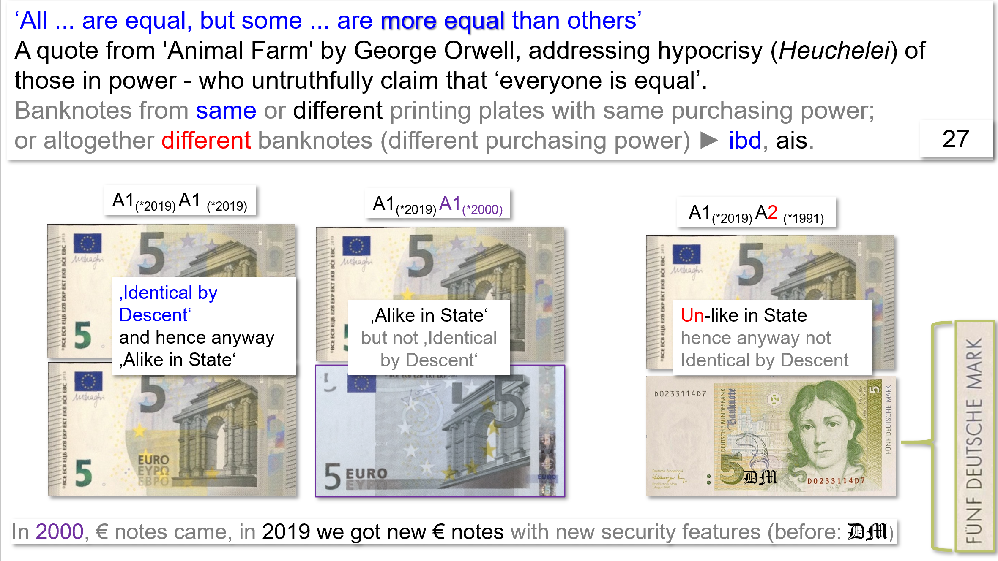
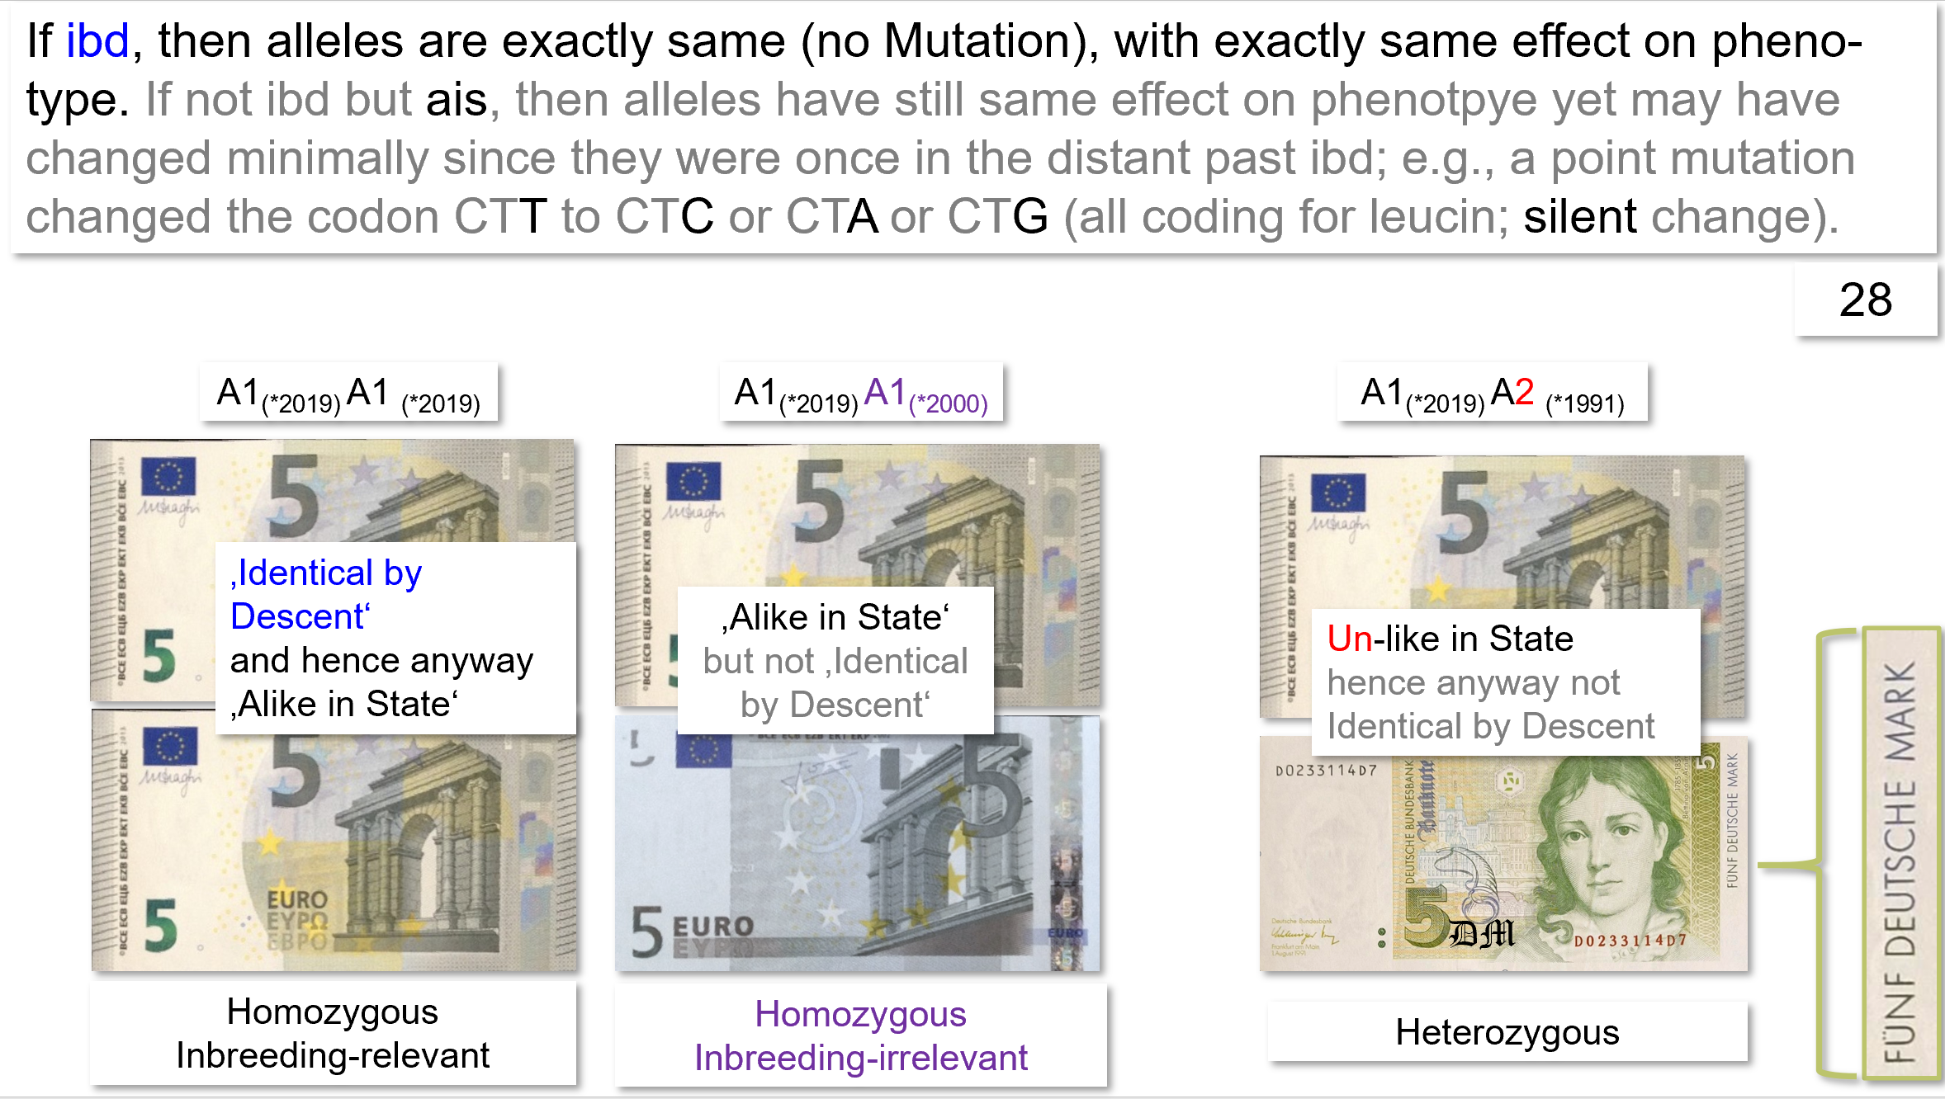
I have included two pages from UNPLAB-PopGen_Ch-3[Inbreeding] in this chapter (pages 27 and 28) . Since you have already studied the chapters on Population Genetics ;-) ... you can skip ahead to the next page. However, if, quite unexpectedly, this is not the case, then perhaps you should go there. Or you can carefully study the screenshots here directly below. The topic is, of course:
What does ‘identical by descent’ really mean, especially in comparison to ‘alike in state’?
16

Slide 17
Remember, think about it, take it all in: Alike in State vs. Identical by Descent
Origin of genes from ancestral individuals
1 2 3 4 5 6
Malécot (1984) introduced the term and concept of „identity by descent, ibd“ (Abstammungsgleichheit). Genes (better: alleles) are identical by descent, if they originated as copies of one-and-the-same gene of a common ancestor. Of course (ignore mutations) ibd-genes are “identical”, and they are alike in state (cause same phenotypic effect) anyway. Being ibd or not is important for the parent-offspring relationship and for the relationship among offspring (cf. UNPLAB-PopGen_Ch-3[Inbreeding], pp. 26-35).
Alleles which are ibd are the ones that steer Kinship and Inbreeding.
Of course there are always gametes which carry same alleles such as A1, although they are not ibd. This is ‚just‘ caused by the fact that the number of alleles per locus is restricted. Being an A1-carrying gamete, you cannot fully avoid to meet a gamete that carries A1, too. This being ‘just-alike-in-state’ leads to the background noise of ‘bit-more-bit-less homozygous and similar’ which is random and is not varying in response to pedigree and inbreeding.
DOI 10.1093/genetics/152.2.477; DOI 10.1038/nrg1960
Three Parents
A₁A₁
A₁A₂
A₂A₂
A₁
A₁
Off-spring
X
A₁A₁
A₁A₂
Y
One out of four cases
Alike in state, but not identical by descent
Identical by descent (thus alike in state anyway)
Not alike in state, not identical by descent
Pedigree shows individuals X and Y. They are half-sib siblings, they share one common parent; it therefore may happen they share (copies of) the allele A1as ibd.
17

Slide 18
Verwandtschaftskoeffizient zweier Genotypen (kinship coefficient, coancestry) f ist die Wahrscheinlichkeit, dass zwei Allele eines Genorts, die zufällig von diesen zwei Genotypen herausgegriffen werden, "aufgrund der Abstammung" identisch sind (abstammungsgleich, herkunftsgleich, ibd).
Der Inzuchtkoeffizient (inbreeding coefficient) F eines Genotyps ist die Wahrscheinlichkeit dafür, dass die beiden Allele, die er an einem zufälligen Genort trägt, "aufgrund der Abstammung" identisch sind.
Kinship coefficient (co-ancestry) of two genotypes f is the probability that two alleles of a genetic locus, which are randomly taken from these two genotypes, are identical "by descent".
The inbreeding coefficient F of a genotype is the probability that the two alleles it carries at random locus are identical "by descent“, ibd.
18

Slide 19
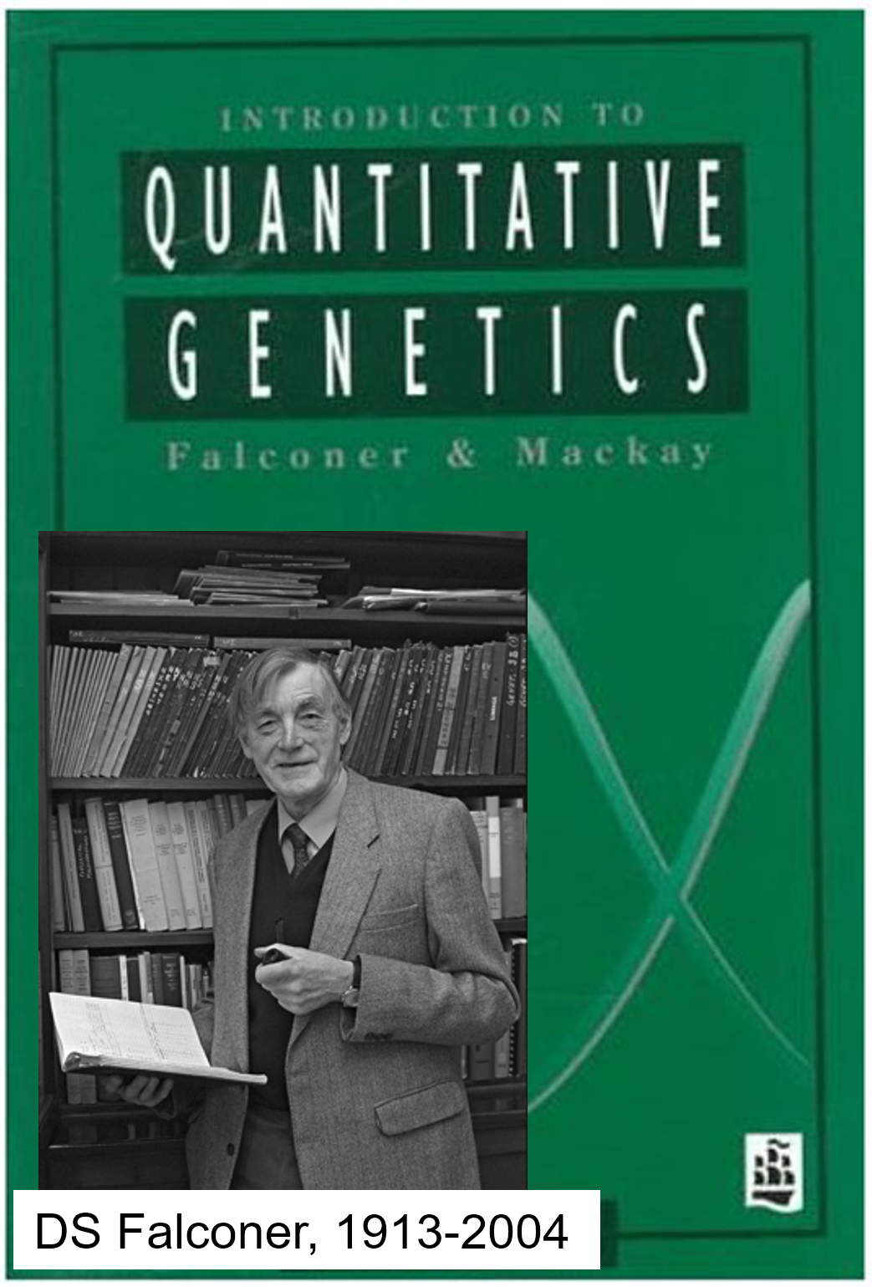
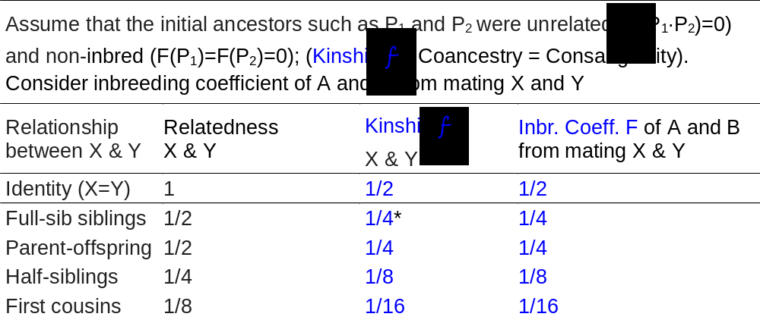
Full-sib siblings ( Full-sibs, FS); Half-sib-siblings (Half-sibs, HS); Parent-offspring; etc.
Offspring is Offspring, but as Offspring mate, it becomes new Parents etc.
Ancestral individuals
Parents
P₁
X
P₂
P₁(A_{i}A_{j}); P₂(A_{k}A_{l})
Photo uploaded by Trudy Mackay www.researchgate.net
Offspring / Parents
X
X
Y
You see: X and Y are full-sib siblings. As the mate … What-then are A and B?
Offspring
A
B
X and Y, both are either A_{i}A_{k} or A_{i}A_{l} or A_{j}A_{k} or A_{j}A_{l} with ¼ probability each. Mating X and Y, the probability that A or B carry the same (ibd) allele twice is F=1/4.
19

Slide 20
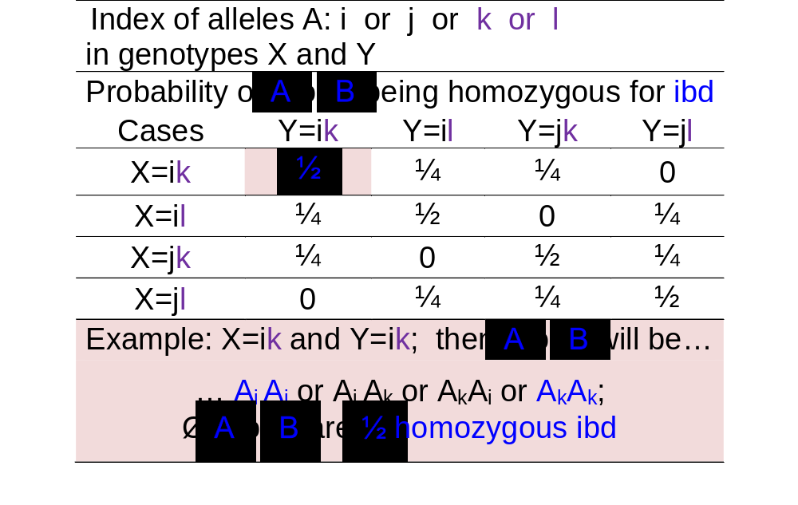
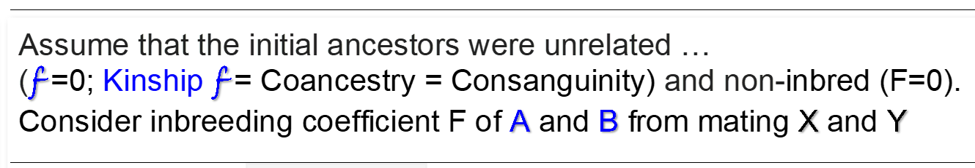
Deduce inbreeding coefficient of offspring from mating ‘normal’ full-sib siblings (X, Y)
Ancestral individuals
Parents
P₁
X
P₂
P₁(A_{i}A_{j}); P₂(A_{k}A_{l})
Offspring / Parents
X
X
Y
You see: X and Y are full-sib siblings.
What-then are A and B?
X and Y, both are either A_{i}A_{k} or A_{i}A_{l} or A_{j}A_{k} or A_{j}A_{l} with ¼ probability each. Mating these two fullsib siblings X and Y, the probability that their offspring A and B carry twice the same (ibd) allele is F=1/4
You see it above; this is Ø of 4∙½; 4∙0; 8∙¼ .
Offspring
A
B
The inbreeding coefficient F from mating two ‘normal’ full-sib siblings is F=1/4
20

Slide 21
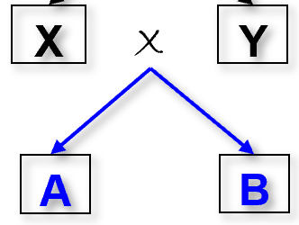
If ‘normal’* full-sibs X and Y mate, then their offspring A and B is inbred by F=1/4
This ‚Relatedness‘ follows the normal way of thinking. Identity means X and Y share 100% of alleles. Half-Sibs for instance share 25% of genes.
For our purpose we rather work with this ‚Kinship‘ f parameter, because f describes and follows the inbreeding and covariance perspective.
*‘normal’? In the sense of ‘their parents were not related nor inbred’.
21

Slide 22
If ‘normal’* full-sibs X and Y mate, then their offspring A and B is inbred by F=1/4
*X and Y are in this* case full-sibs; their full-sib coancestry,
i.e. kinship f (X∙Y) = 1/4. Again: This is the probability that two gametes taken at random, one from X and the other from Y, carry alleles that are ibd.
The inbreeding coefficient F of offspring A or B from crossing these X and Y
is identical to their kinship f (X∙Y) … it is in this* case 1/4.
F_{A} = F_{B} = f (X∙Y). “ Abstammungswahrscheinlichkeit f ”
*‘normal’? In the sense of ‘their parents were not related nor inbred.
22

Slide 23
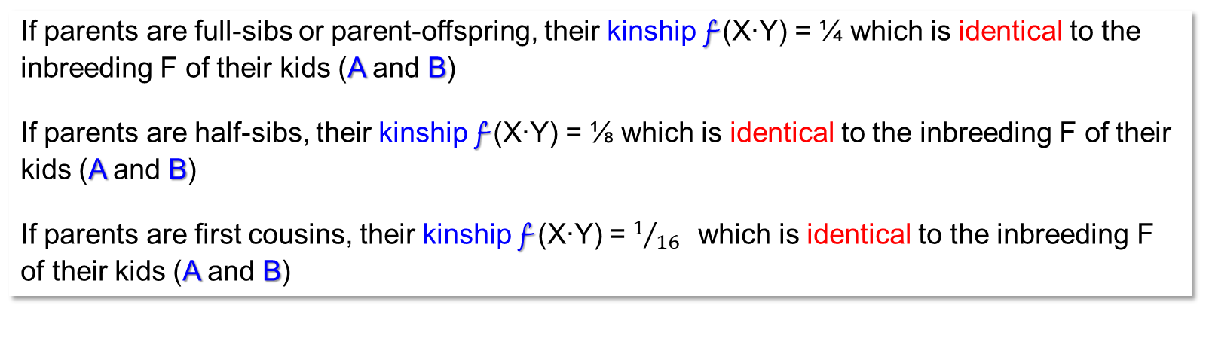
“The tighter the parameter f is, the higher is F”.
Indeed, yes, but the connection is not just such association.
This connection is
!! ‘=‘ !!
Kinship f (X∙Y) is = identical to F_{A} and F_{B}.
If parents are full-sibs or parent-offspring, their kinship f (X∙Y) = ¼ which is identical to the inbreeding F of their kids (A and B)
If parents are half-sibs, their kinship f (X∙Y) = ⅛ which is identical to the inbreeding F of their kids (A and B)
If parents are first cousins, their kinship f (X∙Y) =$1/{16}$which is identical to the inbreeding F of their kids (A and B)
23

Slide 24

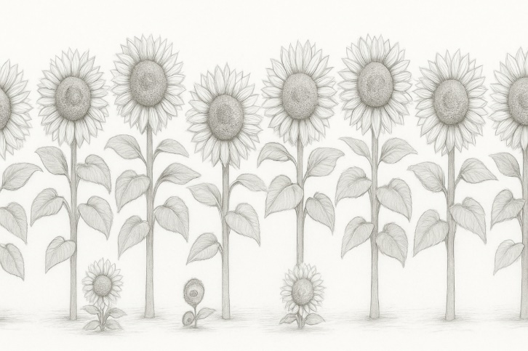
Parents P1, P2 and P3 create full-sibs, half-sibs and parent-offspring relations.
Halfsibs share 25% of genes. Fullsibs share 50% of genes. Parent-offspring share 50% of genes
Parents
X
P₃
P₁
X
P₂
Parent-Offspring (P1 ►◄ X)
Fullsibs (X ►◄ Y), share both parents (P₁, P₂)
Halfsibs (Y ►◄ W), share common parent P₁
We are, of course, dealing with plant families … ;-)
24

Slide 25
Parents P1, P2 and P3 create full-sibs, half-sibs and parent-offspring relations.
Relatives share ibd-alleles, this makes them more similar than unrelated individuals.
Offspring
V
W
X
P₃
Halfsibs (Y ►◄ W), share common parent P₁
Parents
P₁
X
P₂
Parent-Offspring (P1 ►◄ X)
Fullsibs (X ►◄ Y), share both parents (P₁, P₂)
Offspring
X
Y
25

Slide 26
26
Parents P1, P2 and P3 create fullsibs, halfsibs and parent-offspring relations.
Relatives share ibd-alleles, this makes them more similar than unrelated individuals.
V
W
Offspring
V
W
P₃
A_{k}A_{l}
X
P₃
P₁
A_{i}A_{j}
X
Halfsibs (W ►◄ Y)
Two half-sib siblings. W and Y share Ø25% of their alleles. Just as for P-O, their second alleles per locus cannot be ibd. The first locus is either ibd or not (1:1 probability). It is impos-sible for them to share ‘entire loci’.
Parents
P₁
X
P₂
X
P₂
A_{m}A_{n}
Offspring
X
Y
X
Y
Parent-Offspring (P1 ►◄ X).
P₁ and X share 50% of their genes (alleles). It is impossible for them to share entire loci; one allele per locus is shared, whereas the other allele was donated by the (unrelated) parent P₂.
Fullsibs (X ►◄ Y)
Two full-sib siblings. X and Y share Ø50% of their genes. At a given locus, they may share none, one or both alleles with 1:2:1 probability. Thus, they share the entire diploid locus at 25% of the loci!
26

Slide 27
Of course, what was said for (X ►◄ Y) applies for (V ►◄ W) as well et cetera.
V
W
Offspring
V
W
P₃
A_{k}A_{l}
X
P₃
P₁
A_{i}A_{j}
X
Halfsibs (W ►◄ Y)
Two half-sib siblings. W and Y share Ø25% of their alleles. Just as for P-O, their second alleles per locus cannot be ibd. The first locus is either ibd or not (1:1 probability). It is impos-sible for them to share ‘entire loci’.
Parents
P₁
X
P₂
X
P₂
A_{m}A_{n}
Offspring
X
Y
X
Y
Parent-Offspring (P1 ►◄ X).
P₁ and X share 50% of their genes (alleles). It is impossible for them to share entire loci; one allele per locus is shared, whereas the other allele was donated by the (unrelated) parent P₂.
Fullsibs (X ►◄ Y)
Two full-sib siblings. X and Y share Ø50% of their genes. At a given locus, they may share none, one or both alleles with 1:2:1 probability. Thus, they share the entire diploid locus at 25% of the loci!
27

Slide 28
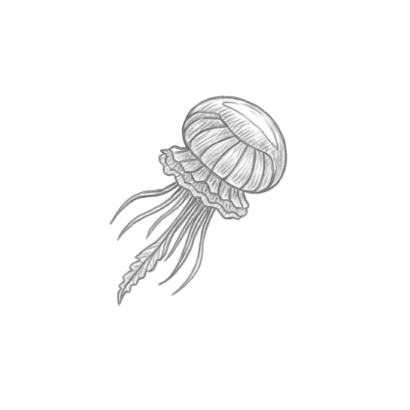
Visualize the HWE-population. Mating ‘all’ possible ♀gametes with all possible
♂ gametes creates the individuals of this population.
‚All‘ gametes in their ♂ version
See N=∞ female gametes mating with N=∞ male gametes, this gives rise to the N=∞ individuals. We do not ask here which gametes came from the same and which came from different parents. It is more like: All male gametes shed into the ‘lottery drum’, same with the female gametes, same drum of course, mating is then female x male and at random. If you like, take the case of jellyfish (Qualle), where eggs and sperms are indeed released into the water and mating is - probably - more or less at random.
There is no family structure, at least none is shown here.
‚All‘ gametes in their ♀ version
We may ask ourselves whether the Random Feature of the HWE setting is realized if we admit that ‚random‘ is not like the case of jellyfish. Rather, first female and male animals mate at random (first layer) and then, second, the gametes of each mating may mate at random (second layer). Or, if all maize pollen (‚thermic‘) is well-mixed, that mixture is mating with egg-cells as they are existing
offered: Packed into different (random) individuals. Try to figure this out by yourself. You will see that even in such two layers, HWE is the result (whether two sexes or hermaphrodites, whether jellyfish or maize or chicken).

Slide 29
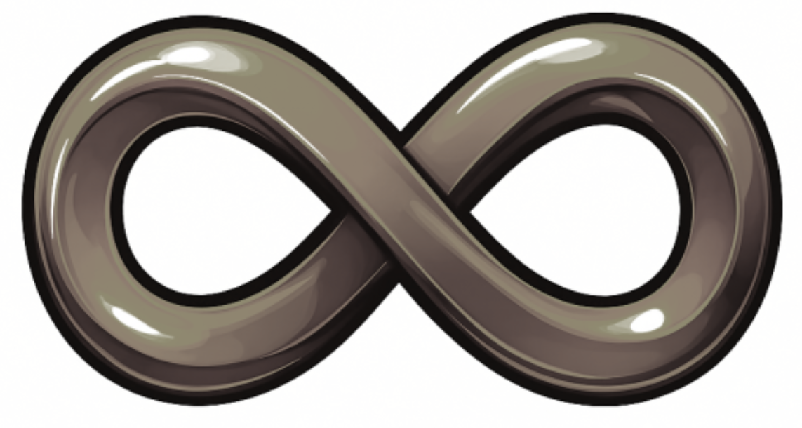
There are of course full-sibs and half-sibs in the HWE-Population; in our much-plagued and much-quoted Reference Population. This here should visualize it.
N=∞ members of the Population
Do not do simply see five random parental individuals mating with other five ones; try to recognise that
what is actually meant here is: Endless many are mated with endless many gametes each ‘perfect-randomly’.
The size of the families is, as well, not five by five (as drawn) but ∞ by ∞. So: There is no issue with limited sample size and limited representativeness
∙ Gametes
∙ Non-inbred random member of the HWE Reference Population
∙ Random gametes
∙ N=∞ offspring from crossing two random members from the HWE population
N=∞ members of the Population
Take the diagram to ponder the total amount of genetic variance in the population and how it is subdivided into the variance (1) between the families and the va-riance (2) within the families.

Slide 30
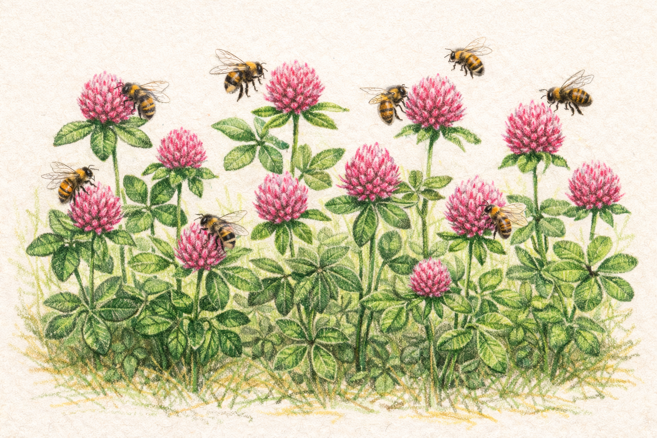
From here you may go to UNPLAB-QuGen_Ch-13[GenetCov II]
Quantitative Genetic model of Genetic Similarity between Relatives
(Genetic Covariance)
Trifolium pratense is red clover. It is a herbaceous plant, a small-seeded legume, autochthone in the so-called Old World.
It is a cross-fertilizing species. This reproductive behaviour is based on its gametophytic self-incompatibility system.
Doi: 10.1007/s00122-010-1347-0.
Red clover and some pollinators.
30

